Slide 1

PERCEPTAI: A SMART AI SYSTEM THAT SEES, READS, AND SPEAKS
Presented by:
23RH1A6609 Allada Sahitya
23RH1A6649 Brunda Siddenki
23RH1A6665 Ch Shaline Siri
Under Guidance of: Ch.Sandeep Reddy

Slide 2
INTRODUCTION
With rapid advancements in AI and computer vision, intelligent systems can now interpret visual data similarly to humans. However, most vision systems focus only on object detection and ignore real-world assistive needs such as:
Reading printed text
Recognizing currency
Understanding human emotions
Operating without physical interaction
PERCEPTAI bridges this gap by integrating multiple AI perception modules into a single real-time system that actively sees, reads, understands, and speaks, making it suitable for assistive and smart-environment applications.

Slide 3
EXISTING SYSTEM
Uses YOLOv5 model for object detection.
Detects general objects from camera input.
Provides basic visual output.
Works only in normal lighting conditions.
Does not include advanced assistive features.

Slide 4
DISADVANTAGES OF EXISTING SYSTEM
High cost of commercial assistive devices
Single functionality systems
No real-time currency detection
No emotion recognition
Lack of voice command control
Poor performance in real-time environments

Slide 5
SYSTEM REQUIREMENTS
Software Requirements:
Python 3.8+
OpenCV
YOLOv8
PaddleOCR/EasyOCR
DeepFace
PyQt5
SpeechRecognition
pyttsx3
Hardware Requirements:
Webcam
Microphone
Speakers
Minimum 4GB RAM
Standard CPU (GPU optional)

Slide 6
PROPOSED SYSTEM
Step 1: Input Layer
Webcam captures real-time video.
Microphone captures voice commands.
Step 2: Processing Layer
Object detection using YOLOv8.
Currency detection using custom trained YOLO model.
OCR using PaddleOCR / EasyOCR.
Emotion detection using DeepFace.
Image preprocessing using OpenCV.

Slide 7
Step 3: Decision Layer
Filters repeated speech.
Checks persistence for currency detection.
Calculates object distance.
Adds emotion-based response.
Step 4: Output Layer
Audio feedback through text-to-speech.
GUI display with bounding boxes.
Reading mode indicator.

Slide 8
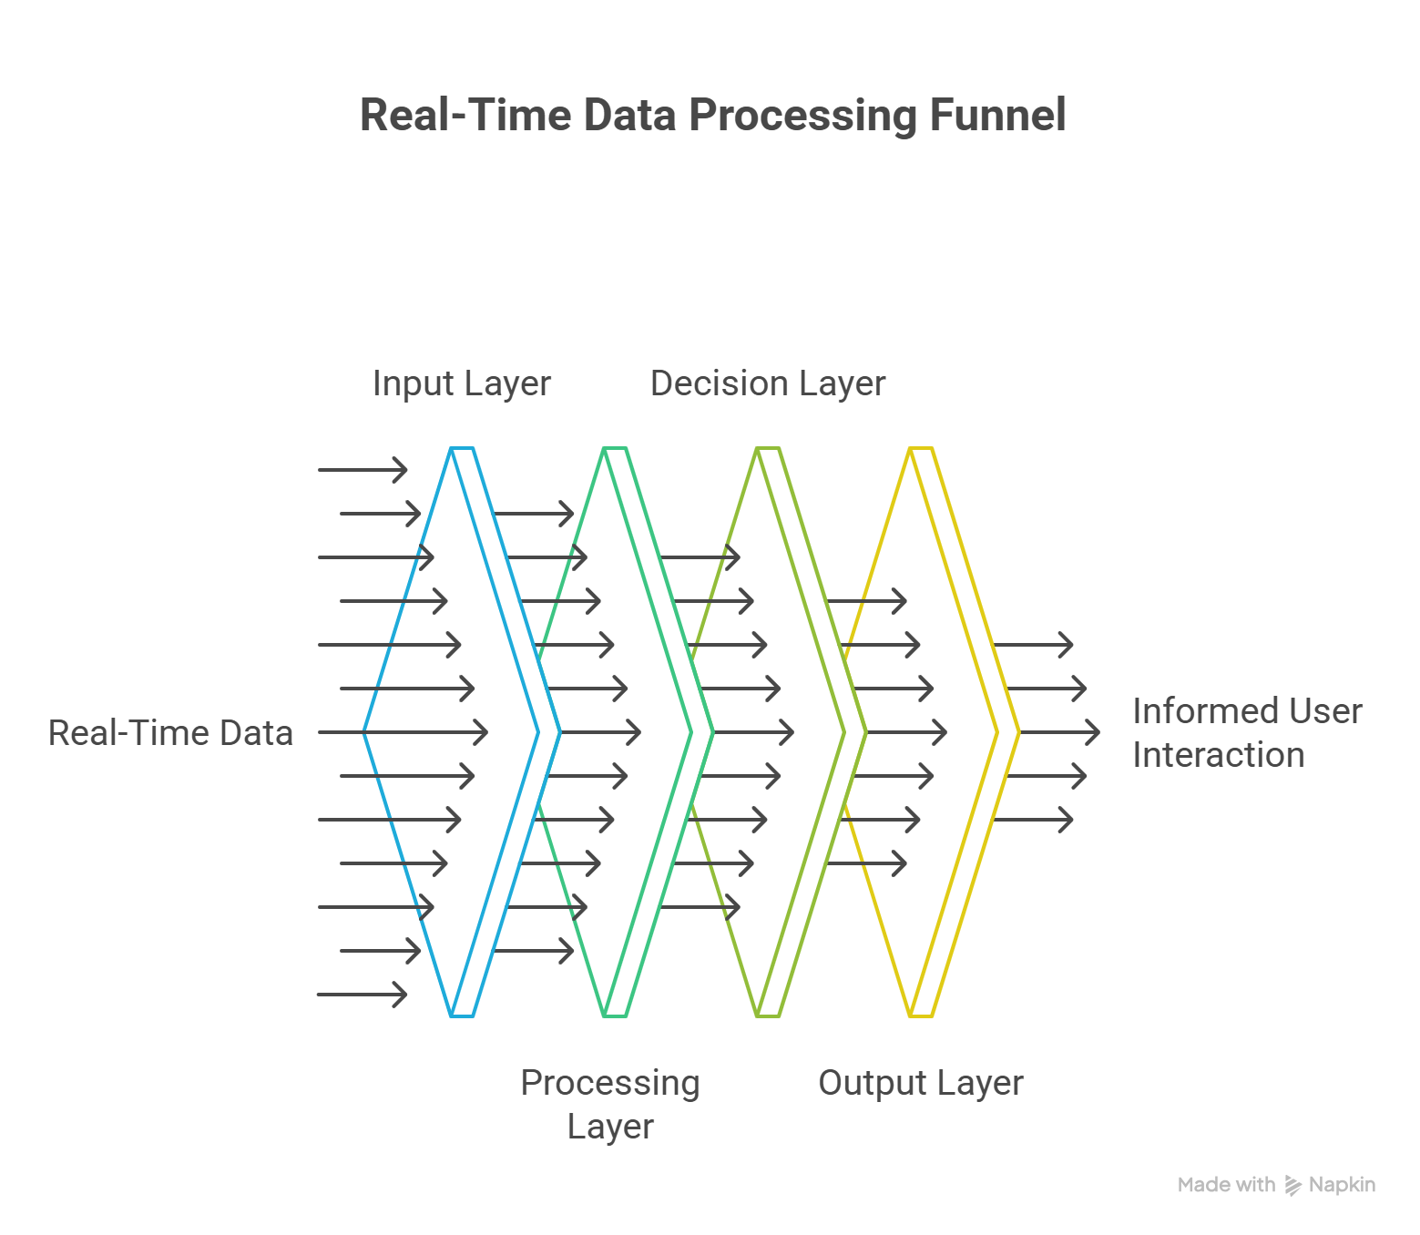
BLOCK DIAGRAM

Slide 9
ADVANTAGES OF PROPOSED SYSTEM
Accurate currency identification
Real-time object detection
Smart reading mode (avoids repetition)
Emotion-aware system
Voice-controlled operation
Distance estimation
Multi-threaded smooth performance
Cost-effective solution
User-friendly GUI

Slide 10
SDG’s MAPPING
SDG 3 – Good Health and Well-Being
Enhances independence and mental well-being of visually impaired users
SDG 4 – Quality Education
Enables access to printed educational material through OCR reading
SDG 9 – Industry, Innovation, and Infrastructure
Demonstrates innovative AI integration for assistive infrastructure
SDG 10 – Reduced Inequalities
Bridges accessibility gaps for people with visual disabilities
SDG 11 – Sustainable Cities and Communities
Supports inclusive smart systems for urban environments

Slide 11
MARKET FEASIBILITY
According to the World Health Organization, over 2.2 billion people globally have vision impairment.
There is a strong demand for affordable assistive technology.
Existing solutions like OrCam MyEye are expensive.
Many available apps provide only limited features.
It uses open-source tools, reducing overall cost.
Can be deployed as desktop or mobile application.

Slide 12
CONCLUSION AND FUTURE SCOPE
Conclusion
PERCEPTAI successfully integrates object detection, emotion recognition, OCR, currency identification, voice interaction, night vision, and time awareness into a unified intelligent system. It moves beyond traditional vision assistants by:
Being context-aware
Supporting hands-free operation
Offering real-world usability
This project demonstrates how AI can actively assist human perception, not just observe.

Slide 13
Future Scope
Multilingual OCR and speech support
Navigation and obstacle avoidance
Face recognition for known individuals
Mobile and wearable device deployment
Cloud-based analytics and learning
Gesture recognition
Integration with smart glasses or AR devices

